Slide 1
Defensa hito 4
Samuel Alejandro Maldonado Garcia

Slide 2
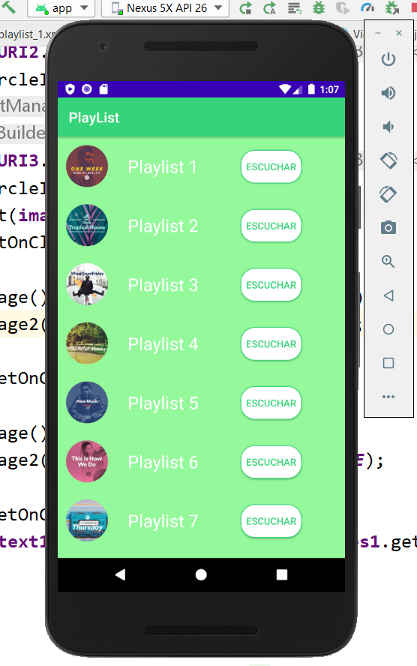
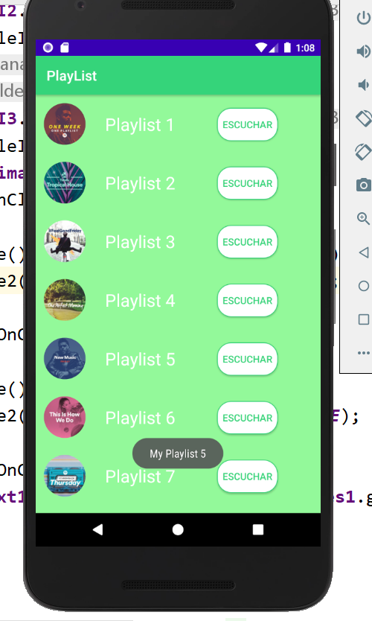
Premisa nª1
Cuando se presiona en el TEXT(Ejem Playlist 5) debe de mostrar un mensaje(TOAST), una descripcion acerca de ese ALBUM(Ejem. "My Playlist 5").
Cuando se presiona en el BUTTON(escuchar) debe de redirigir a un nuevo activity, en donde se mostrara nuevamente un RecyclerView con el listado de las canciones que tiene ese ALBUM.
Al presionar en cualquier de los text se muestra la descripción en un toast.
Al presionar en escuchar la aplicación nos lleva a un nuevo activity.
Para lograr resolver la presente premisa, se utilizó un rvadapter, view holder y librerías extras.

Slide 3
Fragmentos de código
public class RVAdapter extends RecyclerView.Adapter<ViewHolder> { private static final String TAG = "RVAdapter"; private Context context; private ArrayList<String> imageNames= new ArrayList<>(); private ArrayList<String> imagesURI= new ArrayList<>(); public RVAdapter(Context context, ArrayList<String> imageNames, ArrayList<String> imagesURI ) { this.context=context; this.imageNames=imageNames; this.imagesURI=imagesURI; } @Override public ViewHolder onCreateViewHolder(ViewGroup viewGroup, int viewType){ View view = LayoutInflater.from(viewGroup.getContext()).inflate(R.layout.rl_list_item,viewGroup,false); ViewHolder vHolder = new ViewHolder(view); return vHolder; } @Override public void onBindViewHolder(ViewHolder holder, final int position) { String URI = "https://i.imgur.com/"; Glide.with(context) .asBitmap() .load(URI + imagesURI.get(position)+ ".png") .into(holder.getCircleImage()); holder.getTvImage().setText(imageNames.get(position)); holder.getTvImage().setOnClickListener(new View.OnClickListener() { @Override public void onClick(View v) { Toast.makeText(context,"My " +imageNames.get(position), Toast.LENGTH_SHORT).show(); } }); holder.getEscu().setOnClickListener(new View.OnClickListener() { @Override public void onClick(View v) { Intent in = new Intent(context,Playlist_1.class); context.startActivity(in); }}); } @Override public int getItemCount() { return imageNames.size(); } }
public class ViewHolder extends RecyclerView.ViewHolder { private RelativeLayout rlContainer; private CircleImageView circleImage; private TextView tvImage; private Button escu; public ViewHolder( View itemView) { super(itemView); initComponents(itemView); } private void initComponents(View itemView) { rlContainer= itemView.findViewById(R.id.rlListItem); circleImage= itemView.findViewById(R.id.civItem); tvImage= itemView.findViewById(R.id.tvImage); escu=itemView.findViewById(R.id.skip1); } public RelativeLayout getRlContainer() { return rlContainer; } public CircleImageView getCircleImage() { return circleImage; } public TextView getTvImage() { return tvImage; } public Button getEscu() { return escu; } }

Slide 4
Fragmentos de código
public class MainActivity extends AppCompatActivity { private RecyclerView recyclerView; private RVAdapter rvAdapter; private ArrayList<String> imagesName = new ArrayList<>(); private ArrayList<String> imagesURL = new ArrayList<>(); private final String imUR="V4OgA4O,yB3d2qH,9jMbaX2,rYndmdq,sypYnSP,HBeK1ot,YCqbt8r,eLk31XX,4ZHp7FO,XzffKgy,DJabk5C"; private final String imName="Playlist 1,Playlist 2,Playlist 3,Playlist 4,Playlist 5,Playlist 6,Playlist 7,Playlist 8,Playlist 9,Playlist 10,Playlist 11"; @Override protected void onCreate(Bundle savedInstanceState) { super.onCreate(savedInstanceState); setContentView(R.layout.activity_main); initImageBitMaps(); initRecyclerView(); } public void initImageBitMaps() { imagesURL.addAll(Arrays.asList(imUR.split(","))); imagesName.addAll(Arrays.asList(imName.split(","))); } public void initRecyclerView() { recyclerView = findViewById(R.id.rvContainer); rvAdapter = new RVAdapter(this, imagesName, imagesURL); recyclerView.setAdapter(rvAdapter); recyclerView.setLayoutManager(new LinearLayoutManager(this)); } }
<?xml version="1.0" encoding="utf-8"?> <RelativeLayout xmlns:android="http://schemas.android.com/apk/res/android" xmlns:app="http://schemas.android.com/apk/res-auto" xmlns:tools="http://schemas.android.com/tools" android:layout_width="match_parent" android:layout_height="match_parent" tools:context=".MainActivity"> <androidx.recyclerview.widget.RecyclerView android:id="@+id/rvContainer" android:layout_width="match_parent" android:layout_height="match_parent"> </androidx.recyclerview.widget.RecyclerView> </RelativeLayout>
<?xml version="1.0" encoding="utf-8"?> <RelativeLayout xmlns:android="http://schemas.android.com/apk/res/android" xmlns:app="http://schemas.android.com/apk/res-auto" xmlns:tools="http://schemas.android.com/tools" android:layout_width="match_parent" android:layout_height="match_parent" tools:context=".App.Playlist_1"> <androidx.recyclerview.widget.RecyclerView android:id="@+id/rvContainer2" android:layout_width="match_parent" android:layout_height="match_parent"> </androidx.recyclerview.widget.RecyclerView> <androidx.viewpager.widget.ViewPager android:id="@+id/viewPagerContainer2" android:layout_width="match_parent" android:layout_height="match_parent"> </androidx.viewpager.widget.ViewPager> </RelativeLayout>

Slide 5
<?xml version="1.0" encoding="utf-8"?> <RelativeLayout xmlns:android="http://schemas.android.com/apk/res/android" android:id="@+id/rlListItem" android:layout_width="match_parent" android:layout_height="wrap_content" android:background="@color/color2" android:padding="12dp"> <de.hdodenhof.circleimageview.CircleImageView android:id="@+id/civItem" android:layout_width="60dp" android:layout_height="60dp" android:src="@mipmap/ic_launcher_round" /> <TextView android:id="@+id/tvImage" android:layout_width="match_parent" android:layout_height="wrap_content" android:text="@string/canada" android:layout_toRightOf="@id/civItem" android:layout_centerVertical="true" android:padding="8dp" android:textColor="@color/colorWhite" android:textSize="25sp" android:layout_marginStart="20dp" android:clickable="true"> </TextView> <Button android:id="@+id/skip1" android:layout_width="wrap_content" android:layout_marginTop="7dp" android:layout_height="wrap_content" android:layout_marginLeft="250dp" android:background="@drawable/stylesnt" android:text="@string/Escuchar" android:textColor="@color/colorLetra"></Button> </RelativeLayout>
<resources> <string name="app_name">PlayList</string> <string name="canada">Canada</string> <string name="Escuchar">escuchar</string> </resources>
<?xml version="1.0" encoding="utf-8"?> <resources> <color name="colorPrimary">#6200EE</color> <color name="colorPrimaryDark">#3700B3</color> <color name="colorAccent">#03DAC5</color> <color name="colorWhite">#FFFFFF</color> <color name="colorLetra">#36D47A</color> <color name="color2">#93F99A</color> </resources>
<?xml version="1.0" encoding="utf-8"?> <shape xmlns:android="http://schemas.android.com/apk/res/android"> <solid android:color="@color/colorWhite"/> <corners android:radius="20dp"/> <stroke android:width="1dp" android:color="@color/colorLetra"/> </shape>

Slide 6
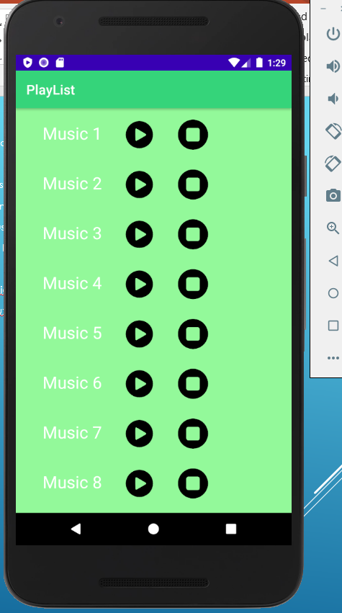
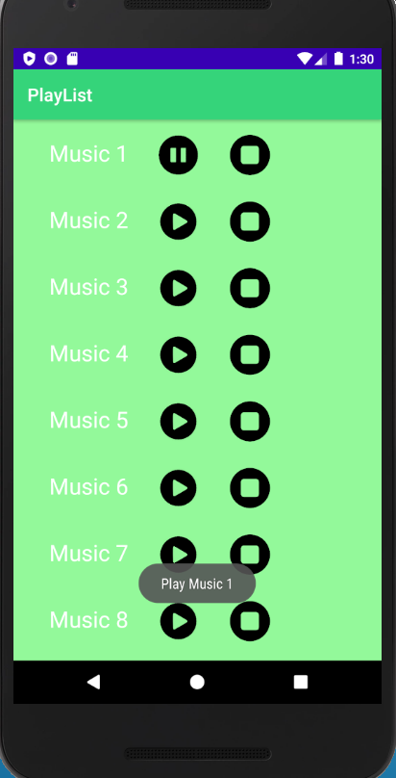
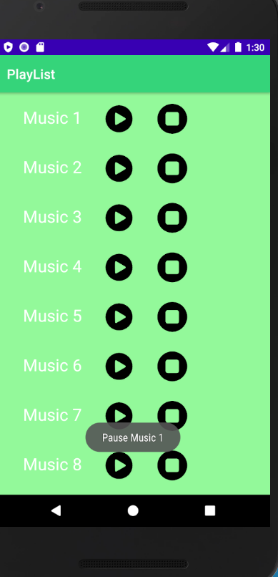
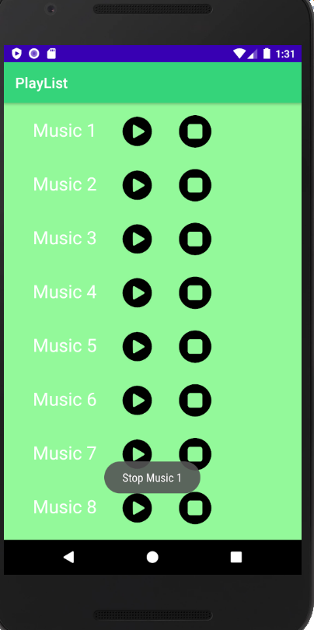
Premisas n° 2 y 3
Mostrar el listado de todas las canciones que forman parte de ese ALBUM.
Cada cancion tiene 3 opciones(PLAY, PAUSE y STOP)
Cuando se presiona PLAY mostrar el TOAST("Play music").
Cuando se presiona PAUSE mostrar el TOAST("Pause music").
Cuando se presiona STOP mostrar el TOAST("Stop music").
Importante, esta opciones no son BUTTONS. Debe de utilizar IMAGEVIEW.
Unificar las opciones PLAY y PAUSE en un solo.
Es decir cuando se hace PLAY debe de cambiar el imageView automaticamente a PAUSE.
Ocurre lo mismo cuando se presiona PAUSE este cambia automaticamente a PLAY.
Al presionar los ImageView de play,pause y stop nos muestra la descripción en un toast y en las opciones de play y pause el manejo es dinámico ya que un ImageView se oculta cuando se presiona el que se desea utilizar.

Slide 7
Fragmentos de código
public class RVAdapter2 extends RecyclerView.Adapter<ViewHolder2> { private static final String TAG = "RVAdapter2"; private Context context1; private ArrayList<String> imageNames1= new ArrayList<>(); private ArrayList<String> imagesURI1= new ArrayList<>(); private ArrayList<String> imagesURI2= new ArrayList<>(); private ArrayList<String> imagesURI3= new ArrayList<>(); public RVAdapter2(Context context1, ArrayList<String> imageNames1, ArrayList<String> imagesURI1 ,ArrayList<String> imagesURI2,ArrayList<String> imagesURI3 ) { this.context1=context1; this.imageNames1=imageNames1; this.imagesURI1=imagesURI1; this.imagesURI2=imagesURI2; this.imagesURI3=imagesURI3; } @Override public ViewHolder2 onCreateViewHolder(ViewGroup viewGroup, int viewType){ View view = LayoutInflater.from(viewGroup.getContext()).inflate(R.layout.rl_list_item2,viewGroup,false); ViewHolder2 vHolder = new ViewHolder2(view); return vHolder; } @Override public void onBindViewHolder(final ViewHolder2 holder, final int position) { String URI = "https://i.imgur.com/"; Glide.with(context1) .asBitmap() .load(URI + imagesURI1.get(position)+ ".png") .into(holder.getCircleImage());
Se utilizó un segundo rvadapter
Glide.with(context1) .asBitmap() .load(URI + imagesURI2.get(position)+ ".png") .into(holder.getCircleImage2()); Glide.with(context1) .asBitmap() .load(URI + imagesURI3.get(position)+ ".png") .into(holder.getCircleImage3()); holder.getTvImage().setText(imageNames1.get(position)); holder.getCircleImage().setOnClickListener(new View.OnClickListener() { @Override public void onClick(View v) { holder.getCircleImage().setVisibility(View.INVISIBLE); holder.getCircleImage2().setVisibility(View.VISIBLE); Toast.makeText(context1,"Play " +imageNames1.get(position), Toast.LENGTH_SHORT).show(); } }); holder.getCircleImage2().setOnClickListener(new View.OnClickListener() { @Override public void onClick(View v) { holder.getCircleImage().setVisibility(View.VISIBLE); holder.getCircleImage2().setVisibility(View.INVISIBLE); Toast.makeText(context1,"Pause " +imageNames1.get(position), Toast.LENGTH_SHORT).show(); } }); holder.getCircleImage3().setOnClickListener(new View.OnClickListener() { @Override public void onClick(View v) { Toast.makeText(context1,"Stop " +imageNames1.get(position), Toast.LENGTH_SHORT).show(); } }); } @Override public int getItemCount() { return imageNames1.size(); } }

Slide 8
<?xml version="1.0" encoding="utf-8"?> <RelativeLayout xmlns:android="http://schemas.android.com/apk/res/android" android:id="@+id/rlListItem2" android:layout_width="match_parent" android:layout_height="wrap_content" android:background="@color/color2" android:padding="12dp"> <TextView android:id="@+id/tvImage" android:layout_width="match_parent" android:layout_height="wrap_content" android:text="@string/canada" android:layout_centerVertical="true" android:padding="8dp" android:textColor="@color/colorWhite" android:textSize="25sp" android:layout_marginStart="20dp" android:clickable="true"> </TextView> <de.hdodenhof.circleimageview.CircleImageView android:id="@+id/civItem1" android:layout_width="45dp" android:layout_height="45dp" android:src="@mipmap/ic_launcher_round" android:layout_marginLeft="150dp" android:layout_marginTop="5dp" /> <de.hdodenhof.circleimageview.CircleImageView android:id="@+id/civItem2" android:layout_width="45dp" android:layout_height="45dp" android:src="@mipmap/ic_launcher_round" android:layout_marginLeft="150dp" android:layout_marginTop="5dp" android:visibility="invisible" /> <de.hdodenhof.circleimageview.CircleImageView android:id="@+id/civItem3" android:layout_width="45dp" android:layout_height="45dp" android:src="@mipmap/ic_launcher_round" android:layout_marginLeft="230dp" android:layout_marginTop="5dp" /> </RelativeLayout>
Se utilizó un segundo ViewHolder
public class ViewHolder2 extends RecyclerView.ViewHolder { private RelativeLayout rlContainer; private CircleImageView circleImage,circleImage2,circleImage3,circleImage4; private TextView tvImage; public ViewHolder2( View itemView) { super(itemView); initComponents(itemView); } private void initComponents(View itemView) { rlContainer= itemView.findViewById(R.id.rlListItem2); circleImage= itemView.findViewById(R.id.civItem1); circleImage2= itemView.findViewById(R.id.civItem2); circleImage3= itemView.findViewById(R.id.civItem3); tvImage= itemView.findViewById(R.id.tvImage); } public RelativeLayout getRlContainer() { return rlContainer; } public CircleImageView getCircleImage() { return circleImage; } public CircleImageView getCircleImage2() { return circleImage2; } public CircleImageView getCircleImage3() { return circleImage3; } public TextView getTvImage() { return tvImage; } }

